Slide 1
Data Science
Instructor:Maham Naeem
September 4, 2024
Central Tendency
Lecture No. 3a

Slide 2
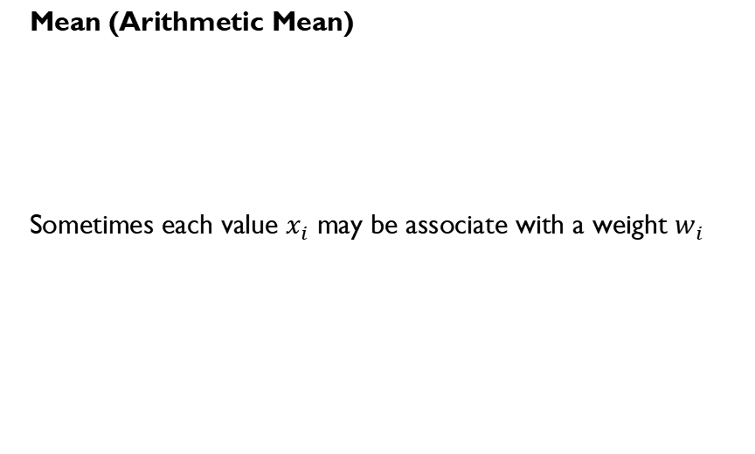
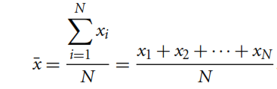


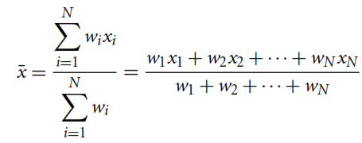
Measuring the Central Tendency
Mean is sensitive to extreme values!
Weighted Arithmetic Mean (or Weighted Average)

Slide 3

Measuring the Central Tendency
Median
The middlemost value of the data (if number of data points are odd)
Average of two middlemost values of the data (if number of data points are even)

Slide 4
Measuring the Central Tendency
Mode
The most frequently occurring value of the data
Datasets with one, two, or three modes are called unimodal, bimodal, or trimodal respectively

Slide 5
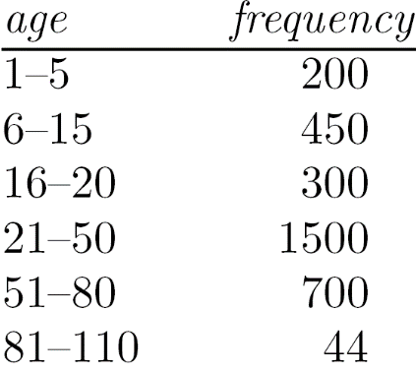
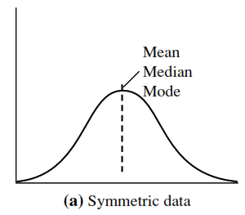
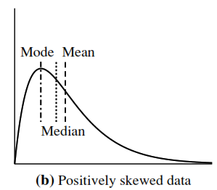
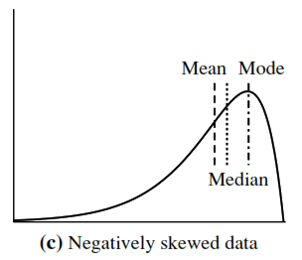
Symmetric VS Skewed Data

Slide 6
Five Number Summary of Dataset
Minimum Value
Lower Quartile (Q1)
Median (Q2)
Upper Quartile (Q3)
Maximum Value
How to compute 5-number summary?

Slide 7
Five Number Summary of Dataset
Sort the data, if not done already.
How to find median if the total number of data points is not odd?
Min
Q1
Median
Q3
Max
56
76
100

Slide 8
Five Number Summary of Dataset
Sort the data, if not done already.
Min
Q1
Median
Q3
Max
56
70
76
86
100

Slide 9
Five Number Summary of Dataset
Sort the data, if not done already.
Called Middle 50% (or IQR)
Any better way to represent this summary?
Lower Extreme
Min
Q1
Median
Q3
Max
56
Lower Quartile
70
Middle Quartile
76
Upper Quartile
86
Upper Extreme
100

Slide 10
MEASURE OF DISPERSION
Variance and Standard Deviation

Slide 11
Variance and Standard Deviation
Data Set 1: 3, 5, 7, 10, 10
Data Set 2: 7, 7, 7, 7, 7
Data Set 1: mean = 7, median = 7
Data Set 2: mean = 7, median = 7
But we know that the two data sets are not identical! The variance and standard deviation shows how they are different.

Slide 12
Variance and Standard Deviation
Both Indicate how spread out a data distribution is.
Square root of variance is called Standard Deviation
A low standard deviation means that data observations tend to be very close
A high standard deviation indicates that data observations are spread over a large range of values
Recall example of Mean we computed earlier…

Slide 13




Variance and Standard Deviation
Variance
Standard Deviation
How many standard deviations away are these data points from mean?

